Slide 1




CNNP
Analyzing the Truncation Mechanism of Epilepsy Under Spatial Patterns
George Zhao
Computational Neurology, Neuroscience & Psychiatry (CNNP) Lab
Newcastle University, UK
www.cnnp-lab.com
Notes:
在这个项目之后，我想积累更多的关于脑电分析的相关经验，因此我在导师的推荐下进入了纽卡斯尔大学计算机学院的一个研究小组作为临时研究助理进行工作

Slide 2
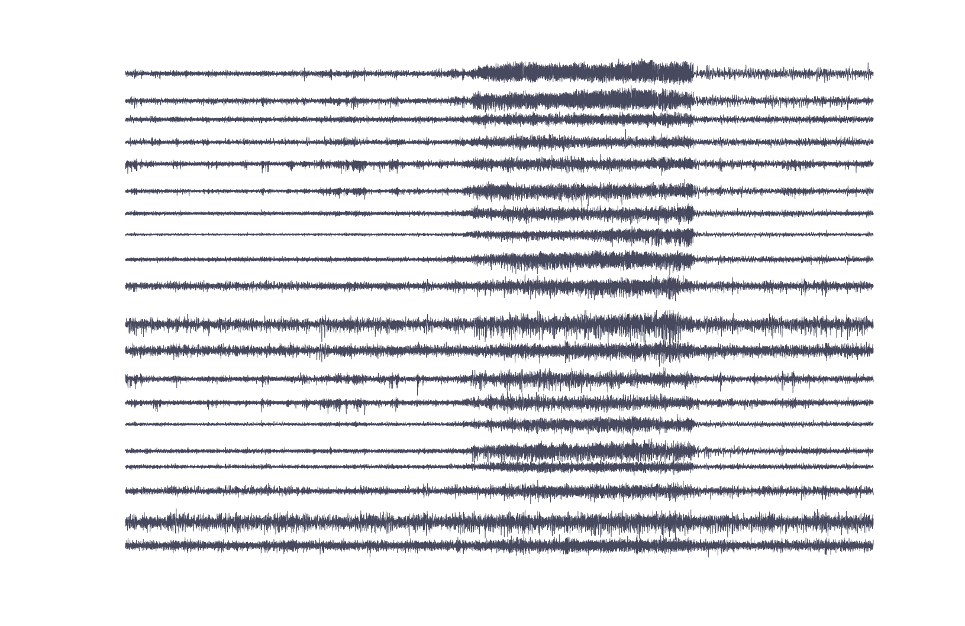
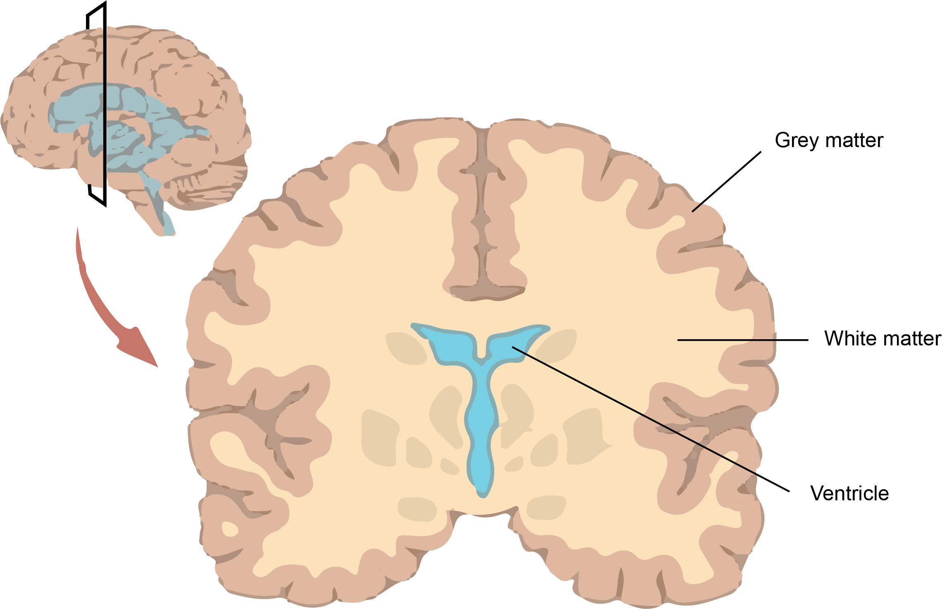
Background
Seizure Spread Mechanism
High-frequency bursts of action potentials and synchronized neuron activity
Spread - ripple effects
Spike discharges on EEG
Role of grey matter and white matter
Spike discharges
Notes:
So, when we talk about seizures, it's fascinating yet complex how they spread. It all starts with hypersynchronous discharges in a small region of the cortex. Picture it like a ripple effect,these discharges then move to nearby areas. The onset of a seizure involves two main things: high-frequency bursts of action potentials and synchronized neuron activity. This synchronized firing shows up as spike discharges on an EEG. As the seizure spreads, it recruits more neurons, breaking down the usual inhibitory controls. This activity can then spread to adjacent and distant parts of the brain through pathways like the corpus callosum. It's like a chain reaction that keeps going and going.
Relevant studies show that brain connectivity is crucial for both normal function and the spread of seizures. Initially, the spread happens through local connections in the brain's grey matter, but after about 300 milliseconds, the larger-scale connections in the white matter take over. However, the exact relationship between white and grey matter in epilepsy propagation is not fully understood.
The way seizures propagate depends on the network's physical properties and how they dissipate energy. The brain's connectivity defines how seizure activity evolves and spreads. While controlling and rerouting this spread is theoretically possible, it's challenging in practice. Disconnecting parts of the brain, like in corpus callosotomy or hemispherotomy, is a drastic measure and is used sparingly due to our limited understanding of network disconnections. Computer models help predict how seizures spread by identifying unstable pathways, showing that both the network's structure and dynamics are crucial.

Slide 3
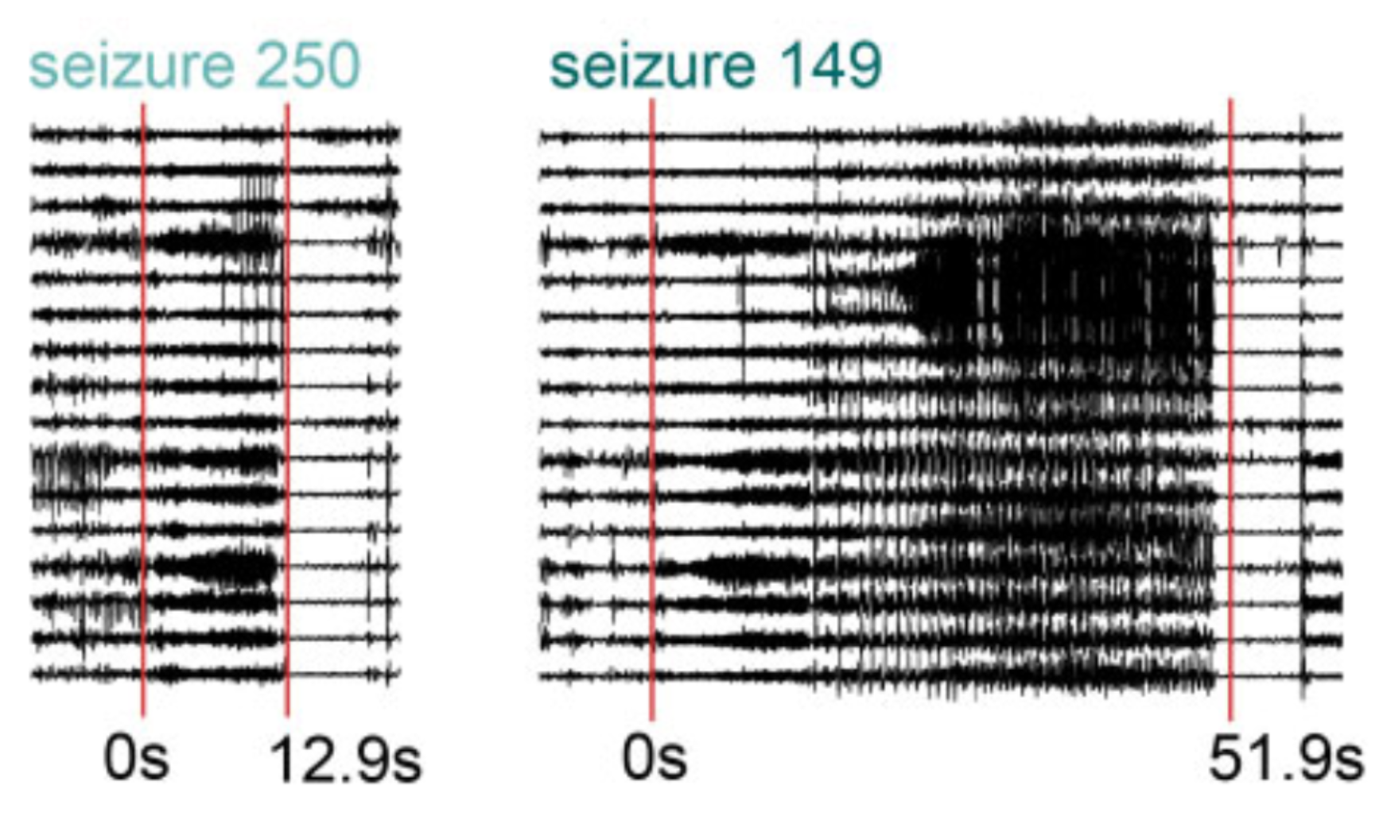
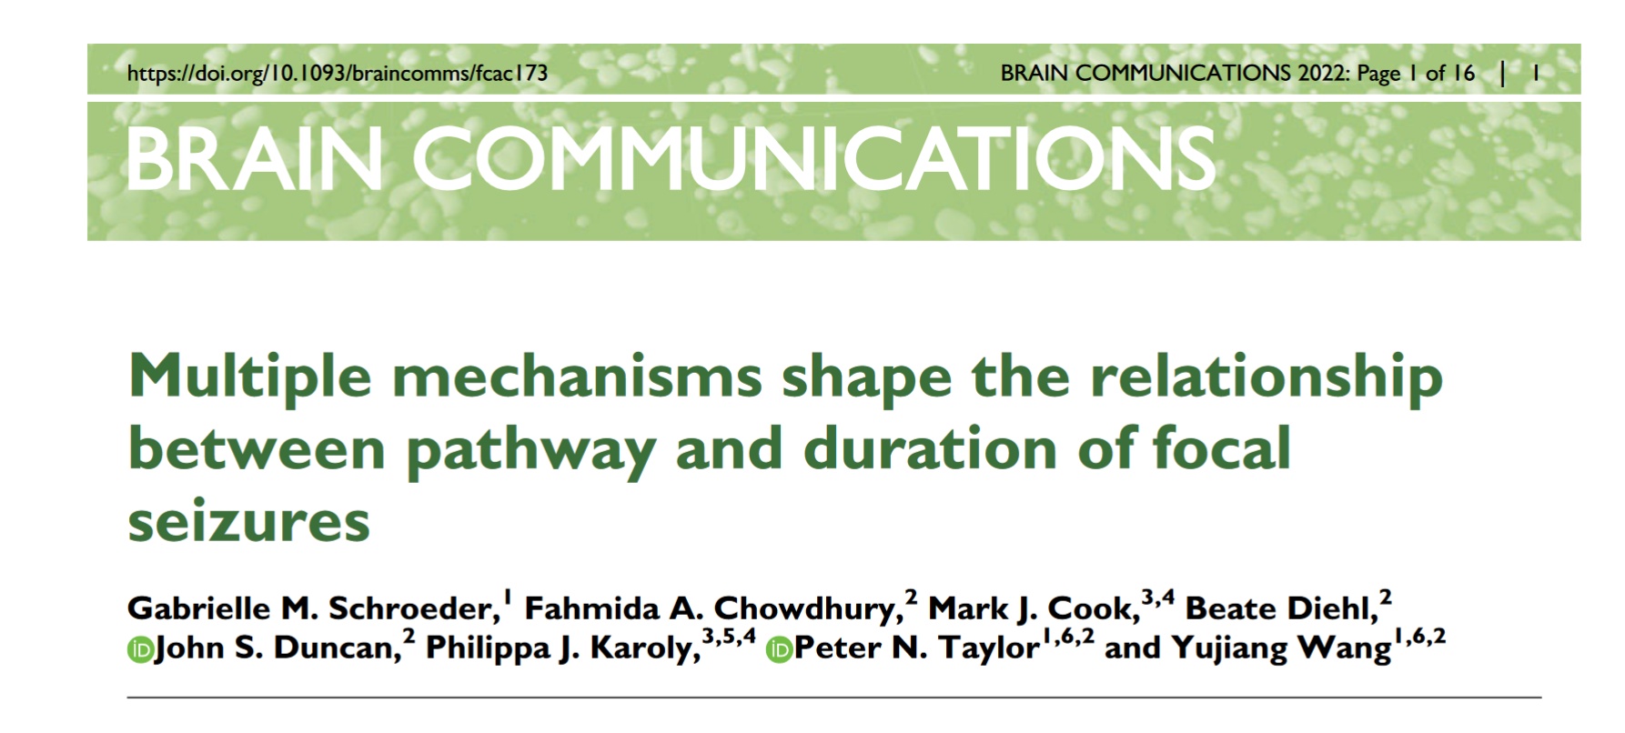
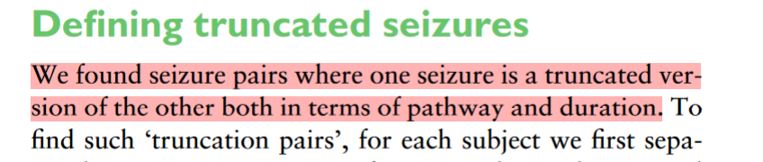
Motivation
“Truncation”
Truncated seizure
Continuing seizure
Factors contributing to 'truncation' and connections between regions
Aim to understand mechanisms behind propagation and interruption
Potential guidance for more effective interventions
Notes:
In a previous paper from our laboratory, we explored the relationship between the pathways of epilepsy propagation and their duration, where we described an interesting phenomenon known as "truncation."
Simply put, among two groups of seizures, they initially have similar starting (imprinted) regions, but as they progress, one stops while the other continues to propagate and even spreads to other areas. It's as if in this pair of seizures, one is a truncated version of the other.
What factors contribute to this "truncation"? What connections exist between the involved regions?
Understanding these issues could enhance our comprehension of the mechanisms behind epilepsy propagation and interruption.

Slide 4
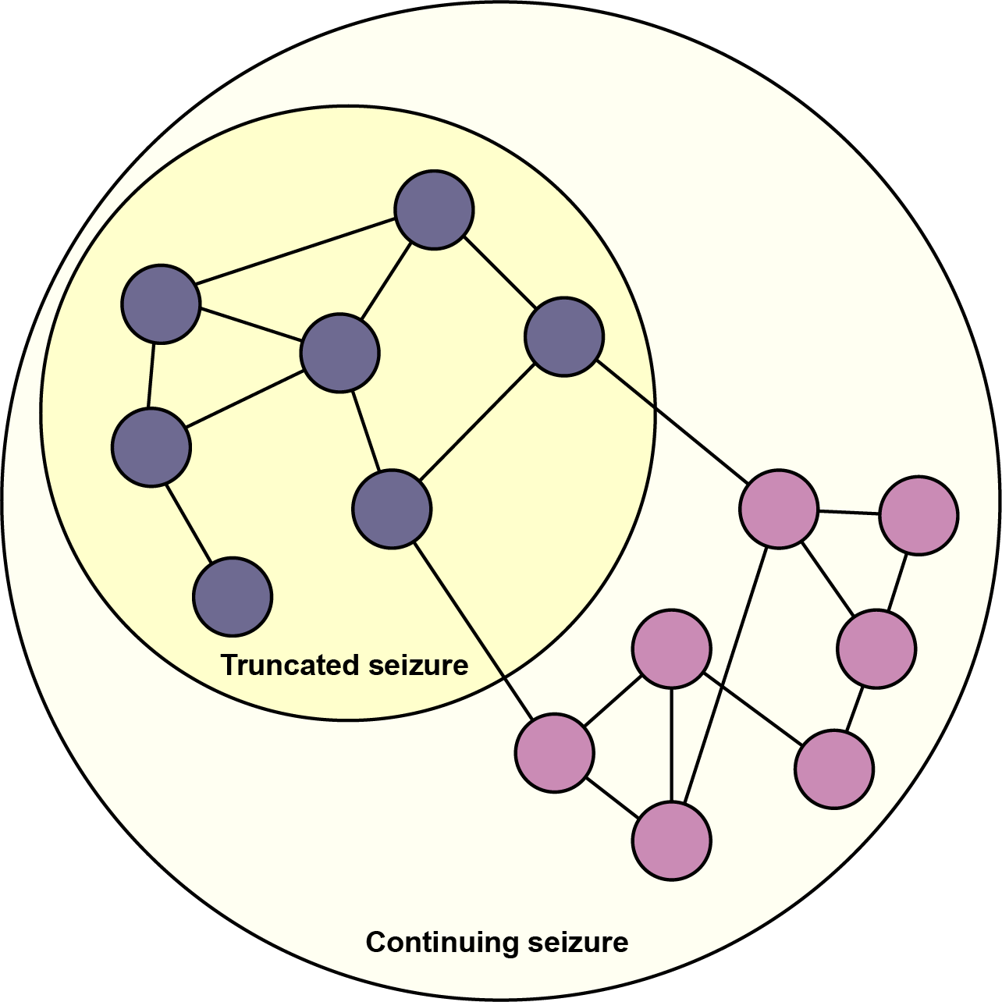
Hypothesis
Seizure propagation tends to be halted around areas of poor connectivity
The seizure propagation may be associated with the connection between white matters (WM) or grey matters (GM).
There is a higher possibility for seizure to terminate when it spreads to certain regions.
Notes:
My hypothesis is that the truncation of seizures are related to the connectivity of the brain, that is, seizure propagation tends to be halted around areas of poor connectivity.
Additionally, there is a higher possibility for a seizure to terminate when it spreads to some certain regions.

Slide 5
Dataset
UCLH iEEG data
549 seizures from 75 patients
White matter connection matrix from 56 controls
Grey matter connection matrix of the pial surface of the MNI 152 atlas.
Notes:
We utilized the epilepsy dataset from UCL Hospital, which includes 513 sets of epileptic seizures from 75 patients.
Additionally, we obtained two adjacency matrices representing the connectivity of white matter and gray matter in the brain.

Slide 6
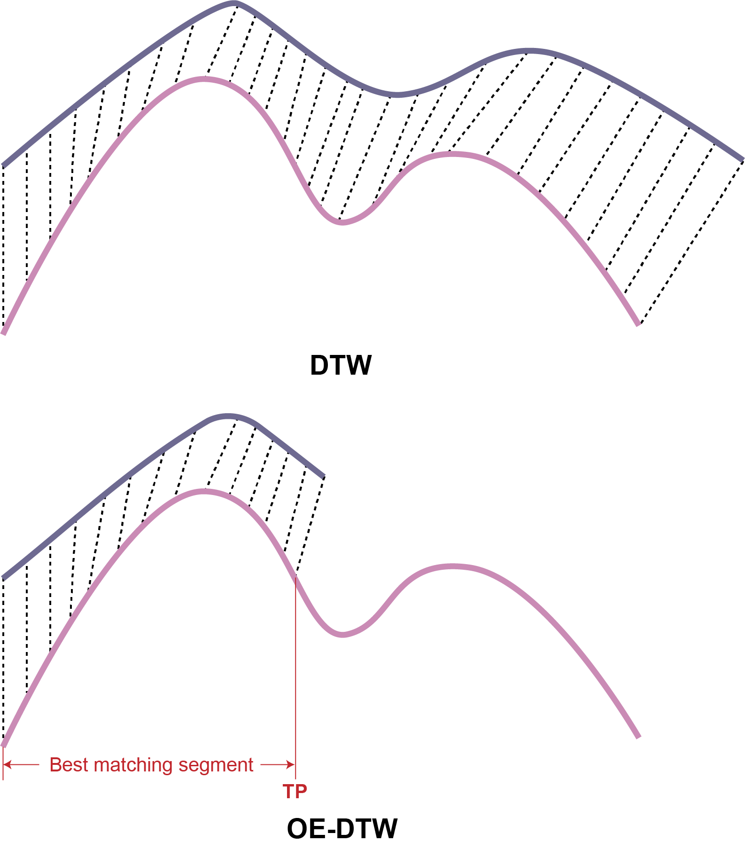
Method
Finding Seizure Pairs Using Open-Ended Dynamic Time Warping (OE-DTW)
OE-DTW enables comparison between incomplete input time series and a complete reference to identify the best matching segment.
We define the endpoint of the best match segment as the truncation point (TP).
Therefore, we can use this segment to replace the incomplete series.
From the dataset, we identified 68 seizure pairs that best exemplify the "truncation", coming from 22 patients.
Notes:
Our work involved two main tasks. The first was to find pairs of seizures that fit our hypothesis. For this, we used the OE-DTW (Optimal Elastic Dynamic Time Warping) method, which helps us find the best match between two groups of seizures. Importantly, this matching can be incomplete, meaning we can identify which parts of a truncated seizure match better with a complete seizure. From our dataset, we identified 68 such pairs of seizures from 22 patients.

Slide 7
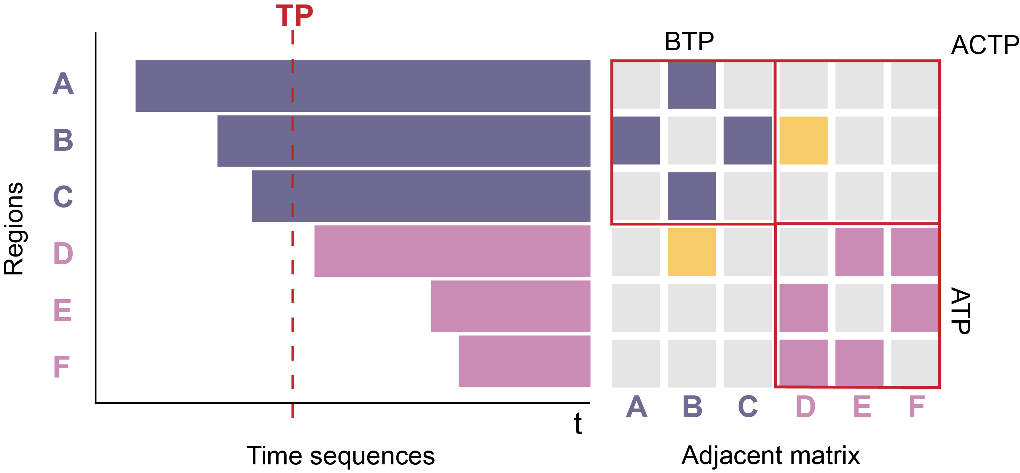
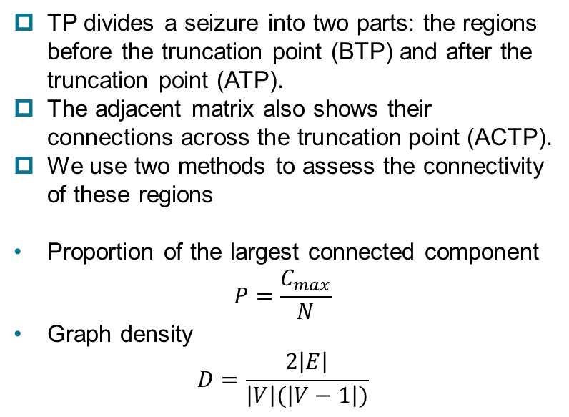
Method
Evaluate connectivity
TP divides a seizure into two parts: the regions before the truncation point (BTP) and after the truncation point (ATP).
The adjacent matrix also shows their connections across the truncation point (ACTP).
We use two methods to assess the connectivity of these regions
Proportion of the largest connected component
$$P=\frac{C_{max}}{N}$$
Graph density
$$D=\frac{2\left|E\right|}{\left|V\right|(\left|V−1\right|)}$$
Notes:
The second task was to calculate the connectivity rates in specific brain regions. Here, we marked the segments of seizures on a timeline and sorted them by their onset times. We also extracted the connectivity matrices for these regions, resulting in the left figure. We referred to the endpoints of the best-matched segments as TP truncation points.
The truncation points divide these regions into two parts: the area before the truncation point and the area after. We used two methods to calculate the connectivity: the largest connected component and graph density. By comparing these connectivity metrics, we want to discover if there are any patterns or rules in their distribution.

Slide 8
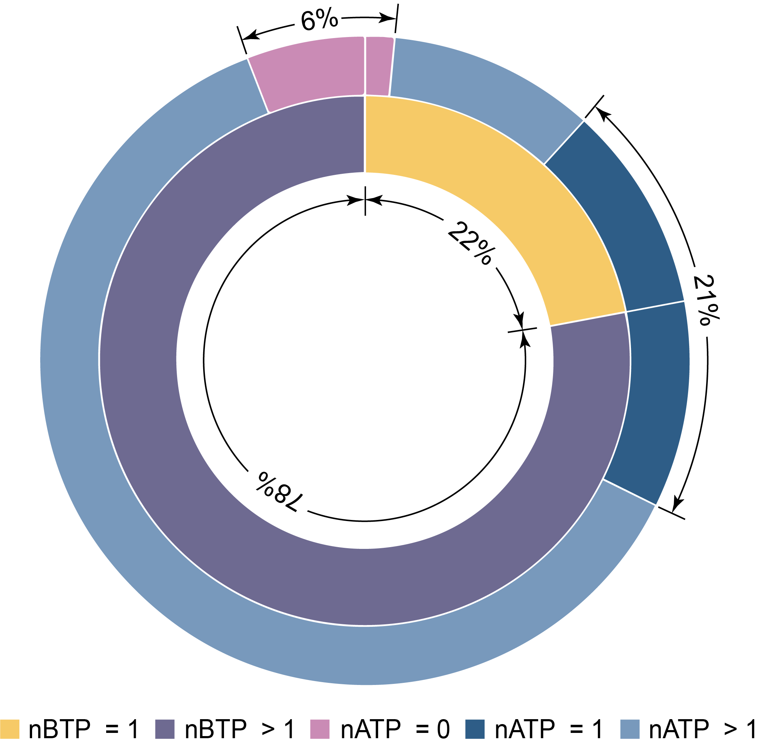
Result
Seizures that do not halt at TP are more likely to spread to more than one area.
Seizures with more than one area before the TP mostly spread to multiple areas
Seizures with just one area before the TP spread to both another region and multiple regions in equal proportions.
Notes:
Below are the results we obtained from our analysis. Initially, we performed statistical analysis on the regions before and after the truncation points (TP). We discovered that the seizures involved in the truncation mostly continued to spread to more than one region after passing the truncation point. For seizures that were only in one region before the TP, they were equally likely to spread to another region or multiple regions. Very few seizures did not spread.

Slide 9
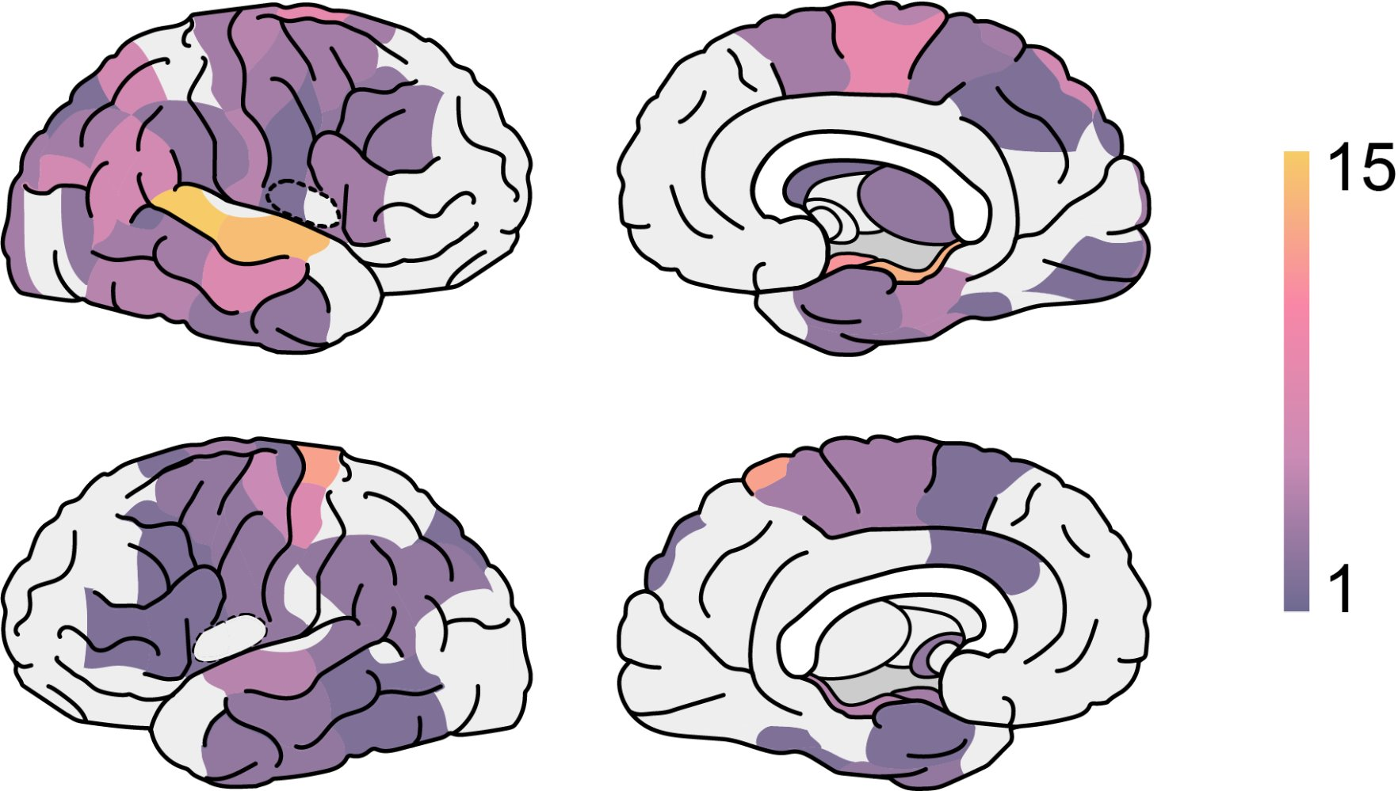
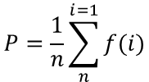
Result
Regions such as the left postcentral, right amygdala, and right superior frontal are often involved in the pre-truncation phase.
$$P=\frac{1}{n}\sum_{n}^{i=1}{f(i)}$$
Notes:
I also analyzed which regions are more likely to be involved in the truncation. For different regions, I balanced their seizure frequency and the distance from the truncation point, and then produced a heatmap representing the probability of a region participating in the pre-truncated stage. In this heatmap, if a region appears brighter, it is more likely to show truncation.

Slide 10
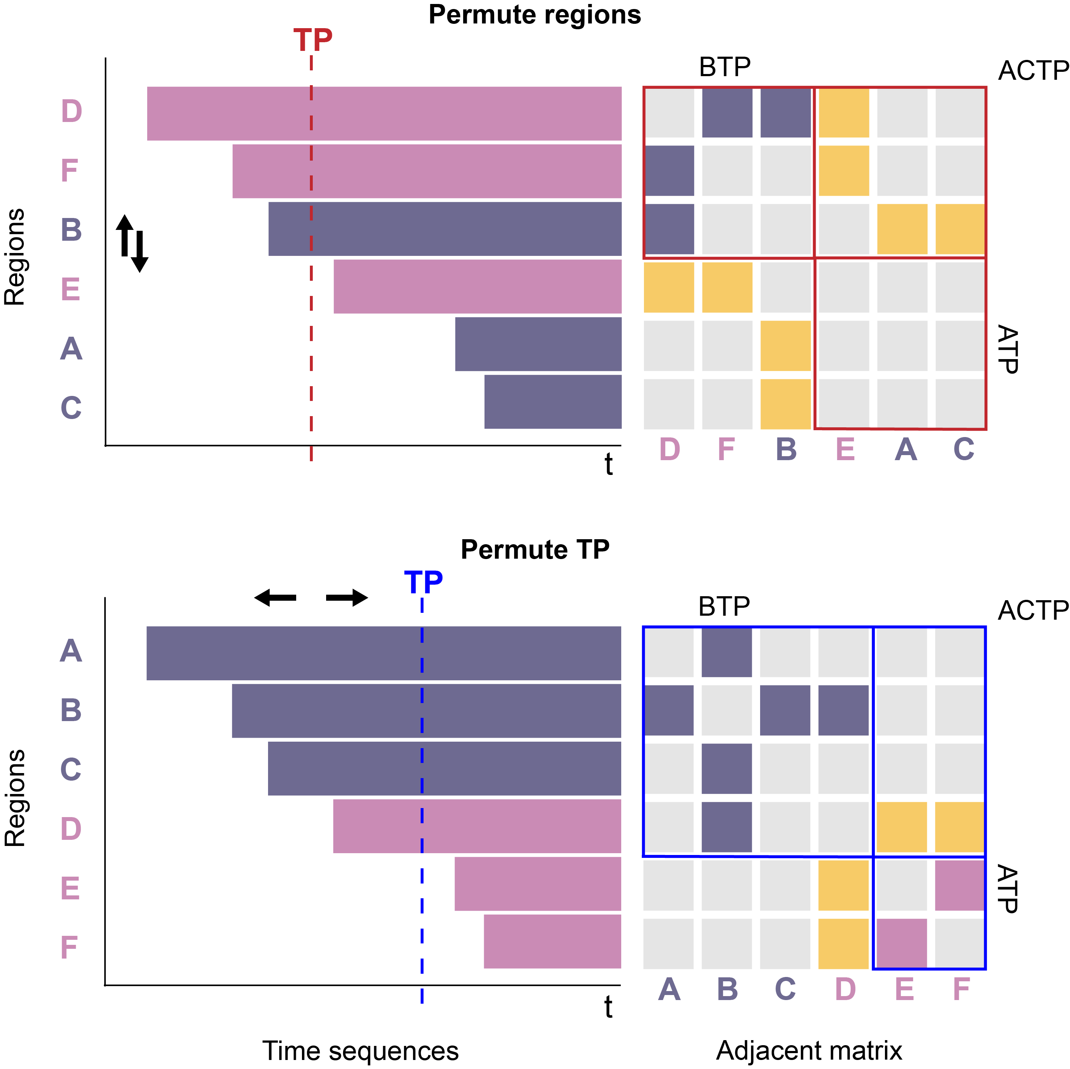
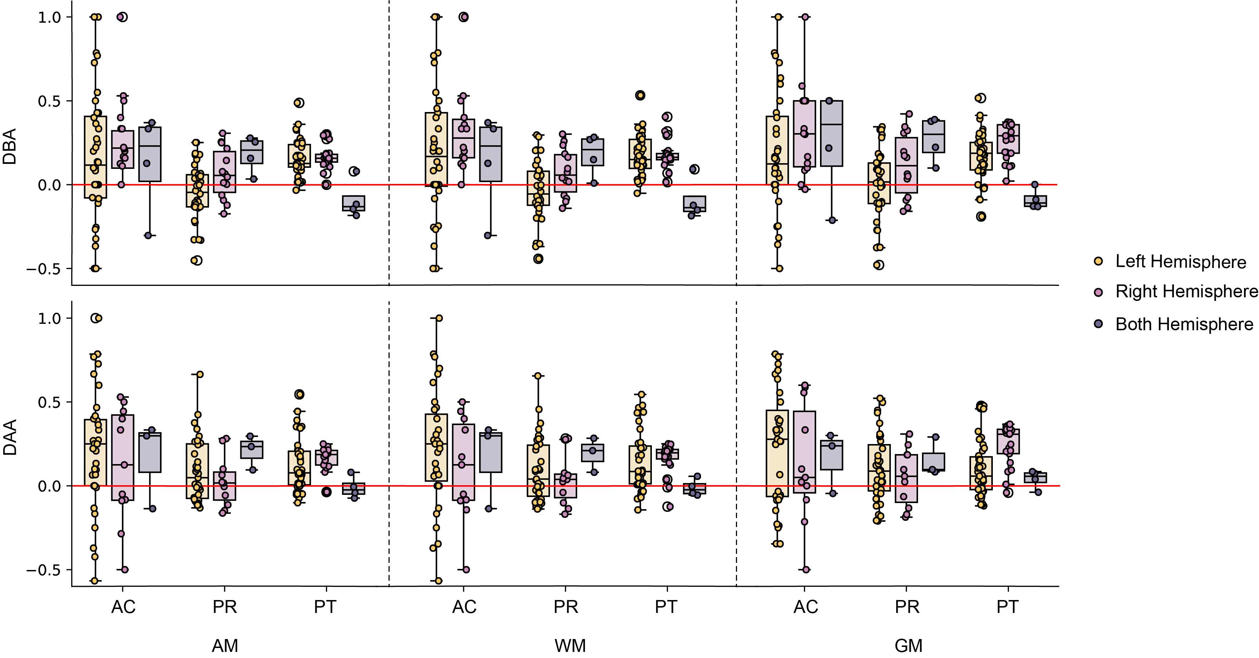
Result
Most regions have stronger intra-group connections rather than inter-group connections.
The results considering all connections are approximately the same as white matter connections.
Actual seizures show a greater difference in connections.
Permutation test (x1000)
The largest connected component
The difference between connectivity BTP and ACTP (DBA)
The difference between connectivity ATP and ACTP (DAA)
Notes:
observed

Slide 11
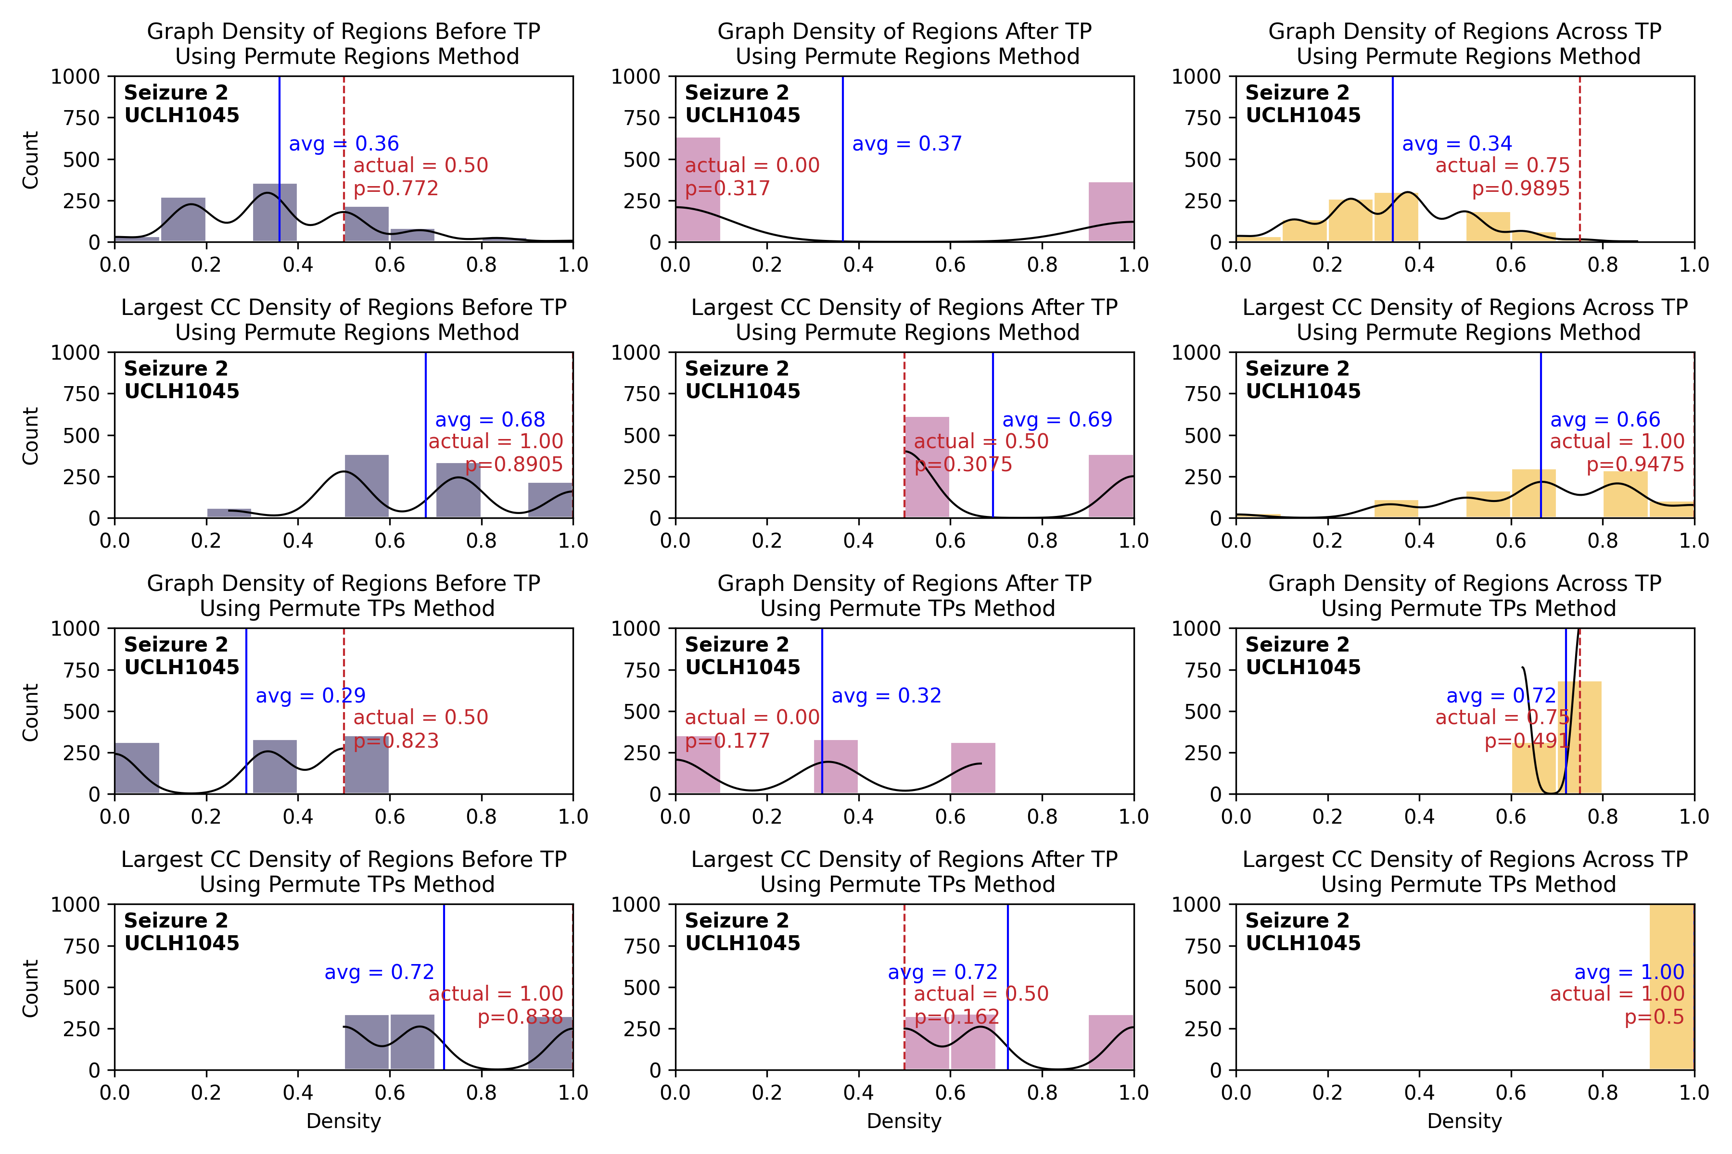
Result
For each seizure for each method

Slide 12
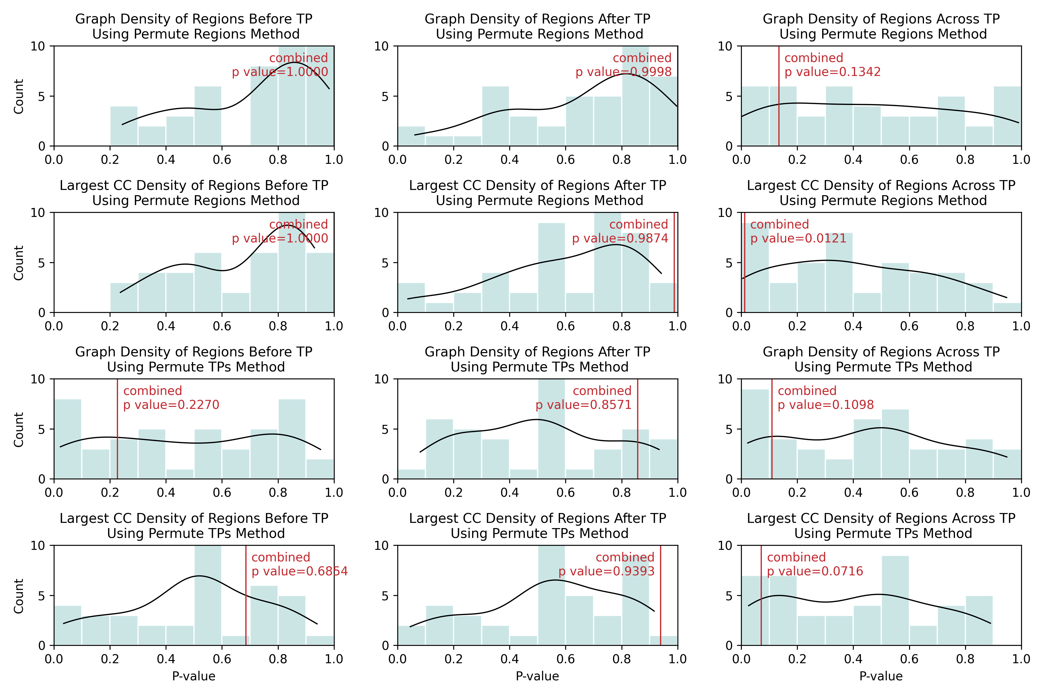
Result

Slide 13
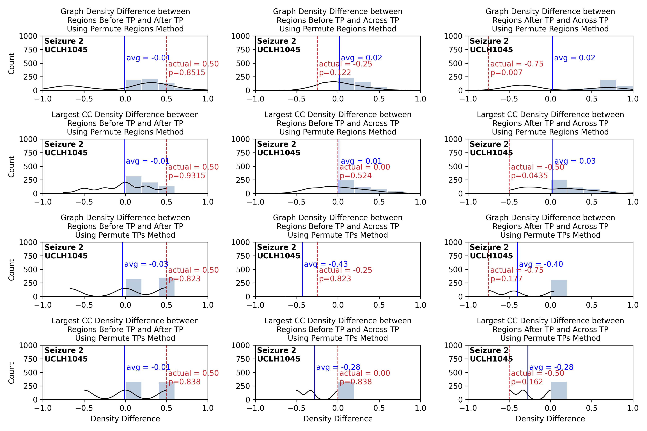
Result
for seizure 2:

Slide 14
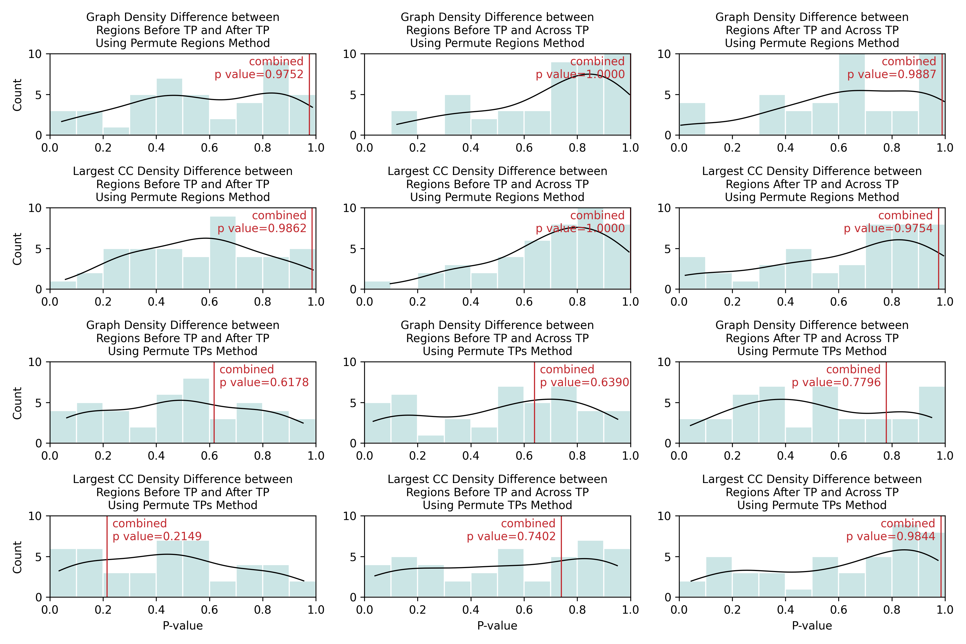
Result

Slide 15
Conclusion
Seizure propagation tends to be halted around areas of poor connectivity
Notes:
In summary, I have employed various methods to validate my hypothesis. Through this work, we have gained a deeper understanding of the patterns of propagation and termination of epilepsy, which will be beneficial for future clinical applications.

